Slide 1
Generics
Java Interlude 1
Data Structures and Abstractions with Java, 4e
Frank Carrano
© 2015 Pearson Education, Inc., Upper Saddle River, NJ. All rights reserved.

Slide 2
Generic Data Types
Enable you to write a placeholder instead of an actual class type
The placeholder is
  A generic data type
  A type parameter
You define a generic class
  Client chooses data type of the objects in collection.
© 2015 Pearson Education, Inc., Upper Saddle River, NJ. All rights reserved.

Slide 3
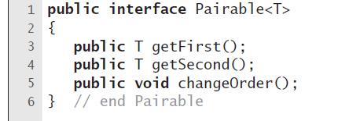
Interface
LISTING JI1-1 The interface Pairable
© 2015 Pearson Education, Inc., Upper Saddle River, NJ. All rights reserved.

Slide 4
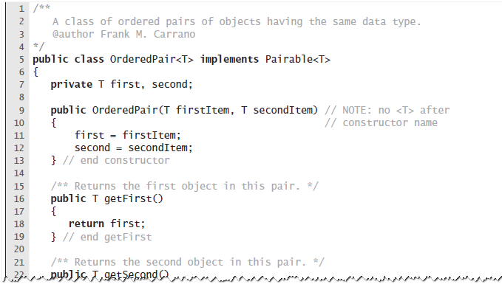
Example
LISTING JI1-2 The class OrderedPair
© 2015 Pearson Education, Inc., Upper Saddle River, NJ. All rights reserved.

Slide 5
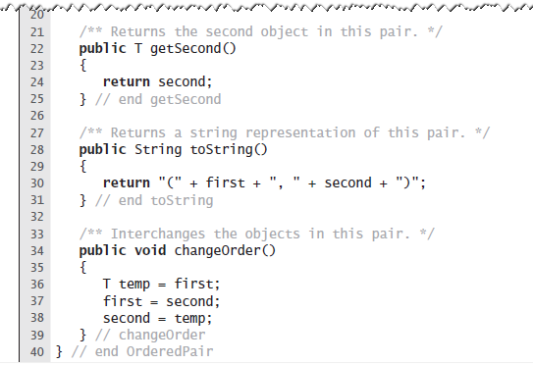
Example
LISTING JI1-2 The class OrderedPair
© 2015 Pearson Education, Inc., Upper Saddle River, NJ. All rights reserved.

Slide 6
End
Java Interlude 1
© 2015 Pearson Education, Inc., Upper Saddle River, NJ. All rights reserved.

